Slide 1
Ecommerce Product Analysis Dashboard
Business Insights & Recommendations

Slide 2
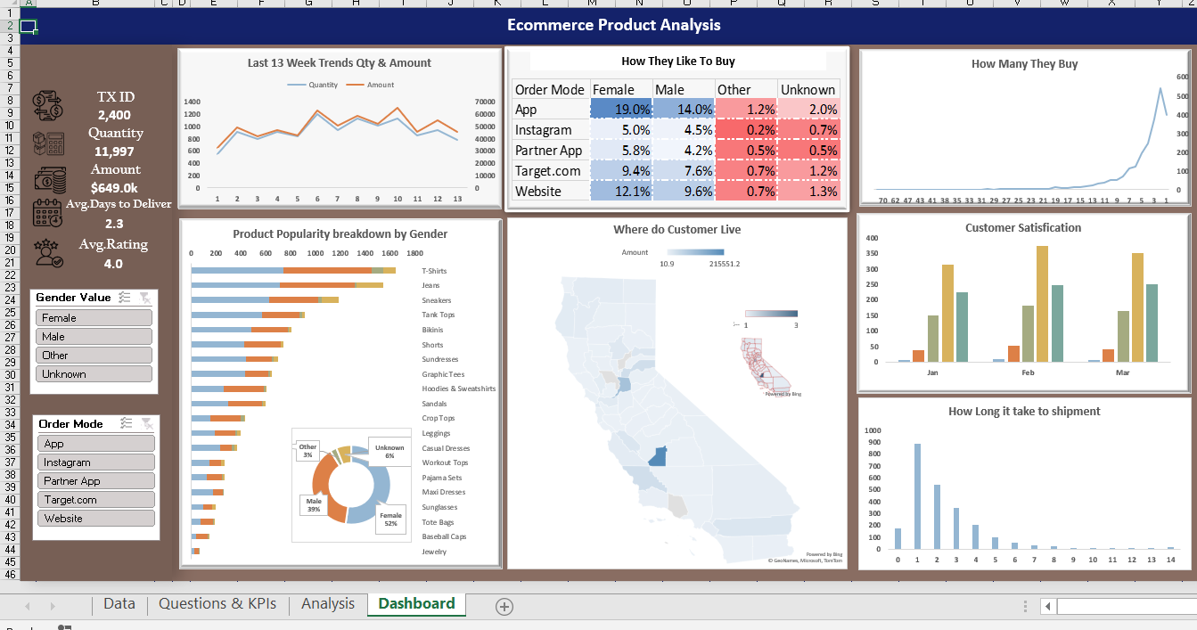
Dashboard Overview

Slide 3
Executive Summary
Transactions: 2,400
Quantity Sold: 11,997
Revenue: $649K
Avg Delivery: 2.3 days
Customer Rating: 4.0
Healthy business with growth opportunities.

Slide 4
Sales Trend Insights
Steady growth over 13 weeks
Peak around weeks 7–10
Demand increasing due to marketing/seasonality.

Slide 5
Purchase Behavior
Top Channels: App, Website
Female customers dominate
Mobile-first business with strong female segment.

Slide 6
Product Insights
Top: T-Shirts, Jeans, Sneakers
Low: Jewelry, Accessories
Apparel drives revenue; accessories need push.

Slide 7
Geographic Insights
Customers concentrated in California
Opportunity to expand to new regions.

Slide 8
Customer Satisfaction
Ratings improving month over month
Majority 4–5 stars
Driven by delivery efficiency.

Slide 9
Delivery Performance
Most deliveries in 2–3 days
Few delays
Strong logistics capability.

Slide 10
Order Behavior
Mostly small orders
Few bulk buyers
Opportunity to increase AOV.

Slide 11
Key Problems
Channel dependency on App
Low accessory sales
Geographic concentration
Low order size

Slide 12
Recommendations
Bundle products
Improve app & channels
Target female segment
Expand geography
Promote low-performing items

Slide 13
Thank You

